Slide 1

Project 2 - Can you hear a reservoir?
Malvin Varpe &
Torgrim Odde

Slide 2
Agenda
Numerical and Analytical Pressure Solutions in Radial Flow
Governing Equation & Transformation
Ex 1: Steady-State Solution
Ex 2: Implicit Transient Solver
Ex 3: Comparison to Line-Source Solution
Solver Performance & Scaling
Ex 4: Well test data matching
Project limitations & Alternatives
Conclusions
Notes:
Malvin will cover

Slide 3
Numerical and Analytical Pressure Solutions in Radial Flow
Modeling fluid flow around well using numerical and analytical solutions
Based on diffusivity equation in cylindrical coordinates
Project structured into 4 exercises
  Steady state solution
  Time dependent solution
  Accuracy & performance
  Well test data fitting
Notes:
Our main learning objectives are to implement finite difference solvers for radial diffusivity—using a logarithmic coordinate transformation—and to compare our numerical steady-state solutions to analytical results. We also build an implicit time solver, form the timestep matrix, and study how boundary conditions, accuracy, and solver choices affect our results. We also use test data for fitting.

Slide 4
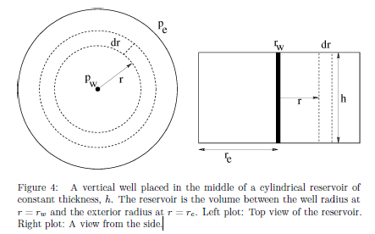

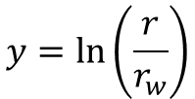
Governing Equation & Transformation
Radial diffusivity equation
Logarithmic coordinate transform
Simplifies operator to a constant-coefficient second derivative in y
$$\frac{δp}{δt}=η\frac{1}{r}\frac{δ}{δr}(r\frac{δp}{δr})$$
$$y=\ln\left(\frac{r}{r_{w}}\right)$$
Notes:
We use the radial diffusivity equation to describe how pressure spreads out from a well. To make the math and calculations easier, we switch from radius $r$ to a new variable y=ln(r/r_w). This change turns the equation into a much simpler form, where the main part is just a constant times the second derivative in $y$. This makes it easier and more accurate to solve with our numerical methods.

Slide 5
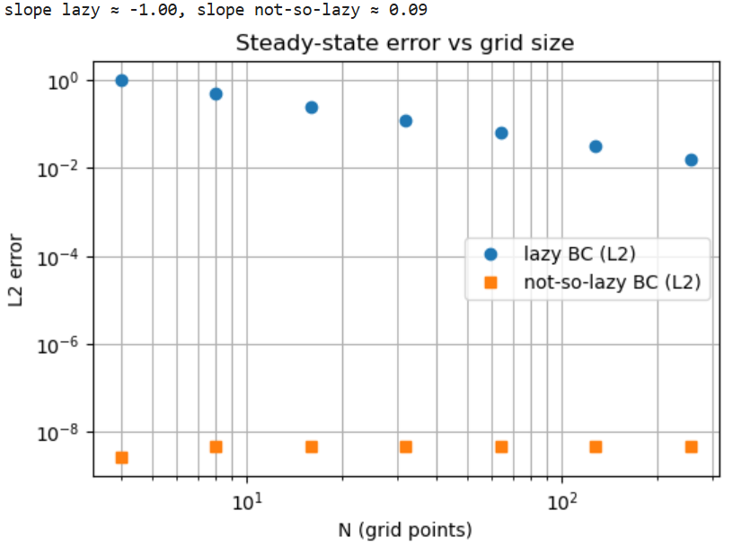

Ex 1: Steady State Solution
Steady state $\frac{d_{p}^{2}}{d_{y}^{2}}=0$
Analytical solution $p\left(y\right)=p_{i}+\text{α}(y−y_{e})$
Lazy vs not-so-lazy BC at $y−y_{e}$
  Lazy: $p_{N}=p_{e}\left(first order\right)$
  Not-so-lazy: Ghost extrapolation (second order)
Notes:
To solve the steady-state problem, we discretize the equation using central differences, resulting in a tridiagonal linear system. For boundary conditions, we test two approaches at the outer edge: the ‘lazy’ method, which sets the last pressure node equal to the boundary value—giving first-order accuracy—and the ‘not-so-lazy’ method, which uses ghost node extrapolation for second-order accuracy. At the well, we handle the Neumann boundary with a ghost node as well. This setup simplifies the discretization and improves numerical stability and accuracy.

Slide 6

Steady State Error Behavior
Lazy BC -> $\text{O}\text{(}\text{Δ}\text{y}\text{)}$
Not-so-lazy BC -> $\text{O}\text{(}\text{Δ}\text{y}\text{^2}\text{)}$ (and exact for linear solution)
Convergence verified manually
Notes:
We measure both L2 and pointwise error against the analytical solution. The lazy boundary condition shows first-order convergence—the error is proportional to the grid spacing. The not-so-lazy method achieves second-order accuracy in the interior, and for our linear steady solution, the error is near round-off. This confirms that midpoint extrapolation at the boundary is preferred for accuracy

Slide 7
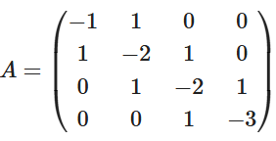

Ex 2: Implicit Transient Solver
Fully implicit time stepping of diffusivity equation
Discretization gives tridiagonal system per timestep
Matrix structure of N = 4
Advantages: Stable for large $\text{Δ}\text{t}$
Notes:
Moving to Exercise 2, we implement a fully implicit time-stepping scheme for the diffusivity equation. This gives us a tridiagonal system to solve at each timestep. The implicit scheme is stable for large timesteps, which is a major advantage. We derive the matrix system, show the actual numerical matrix for given parameters, and implement a general simulator. The solver supports multiple linear solution strategies, and our results show that the matrix matches theoretical coefficients and converges for any timestep due to the implicit scheme. The main limitation is that it’s first order in time, so early time accuracy depends on the timestep choice.

Slide 8
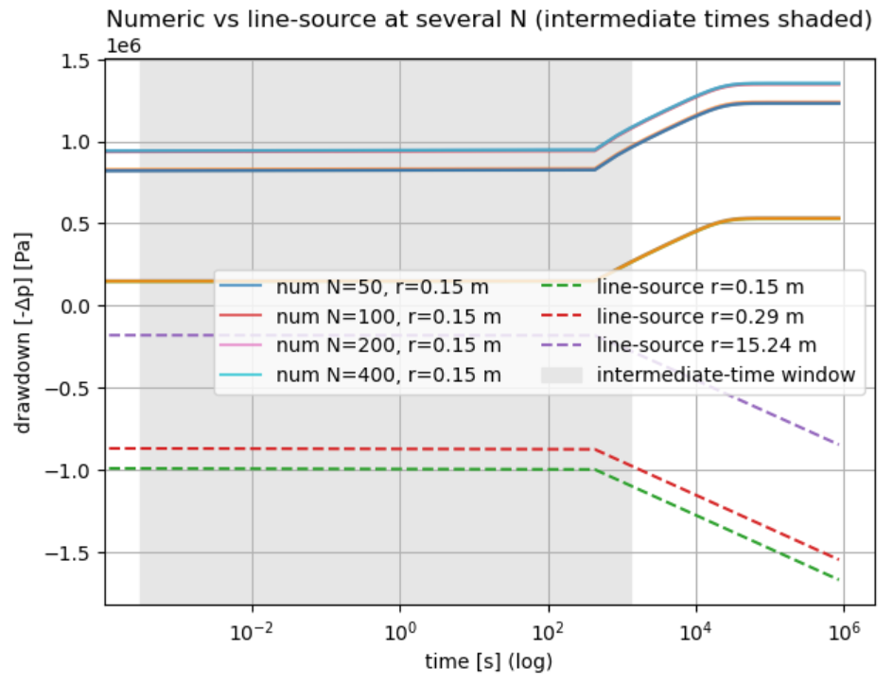
Ex 3: Comparison to Line-Source Solution
Theis (line-source) solution valid in intermediate time
Numerical vs analytical
  Discretization effect at early times
  Excellent match at intermediate times
  Boundary effects at late times
Increasing N improves early/intermediate accuracy
Notes:
Exercise objective:
Compare numerical solution for different N with line-source analytical solution
Plot drawdown vs time in physical radius coordinates
Theory:
Line-source (Theis) solution
Valid for early/intermediate time when boundary is not felt
Beheavior
Early time: Short-term transients
Intermediate: Logarithmic straight line on semilog plot
Late time: Boundary dominated
Implementation:
Compare numerical drawdown for N=50 and N=200 at two radii
Line-source computed analytically
Intermediate time window sahded
Results:
Small deviations from dicretization/transients at early time
Numerical and analytical match closely in intermediate region
Numerical deviates due to boundary, analytical does not at late time
No boundary in line-source
Limitations:
Line source ignores boundary, so late-time differences are expected

Slide 9
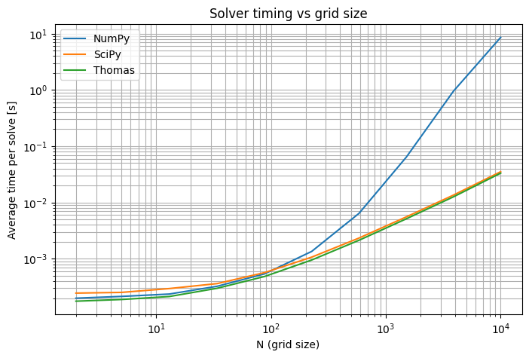
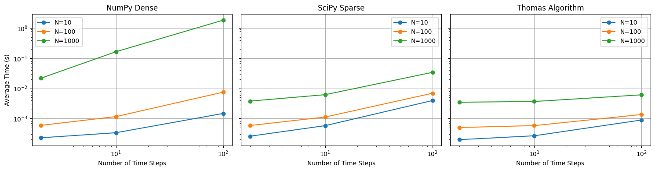
Solver Performance & Scaling
Solvers
  Dense (NumPy) -> Cubic scaling
  Sparse (SciPy) -> Better at mid range N
  Thomas algorithm -> Linear scaling, best overall
Notes:
Exercise objective:
Benchmark 3 solvers; dense (NumPy), sparse (SciPy) and Thomas algorithm
Theory:
Dense solver
Sparse solver
Thomas algorithm
Implementation:
Timing across multiple N and timesteps
Logged average runtime
Results:
For small N, all methods similar (overhead dominates)
Around N~200, SciPy overtakes NumPy
Around N~200 Thomas is fastest
Consistent with theoretical complexity
Expected Thomas to be way faster than SciPy for large N

Slide 10
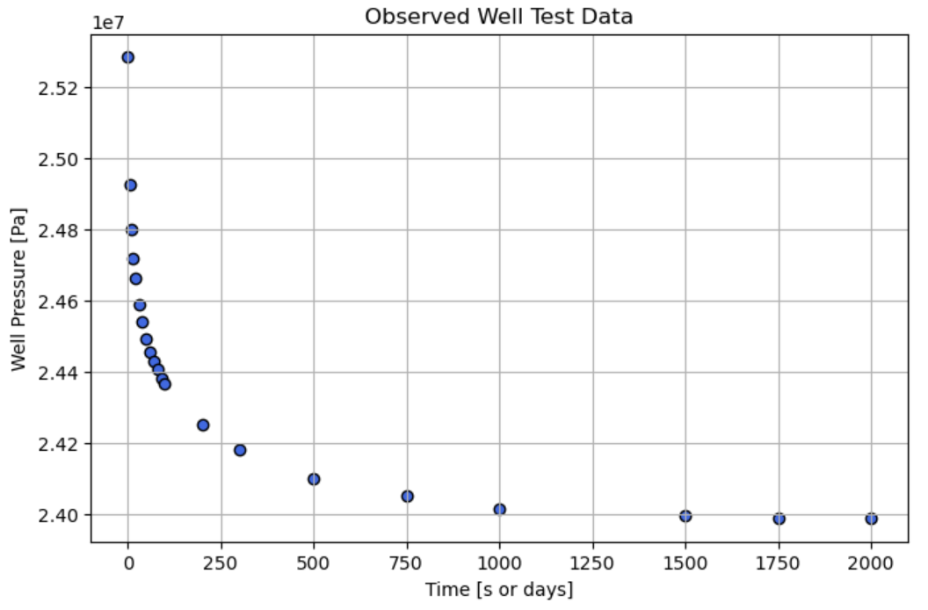

Ex 4: Well Test Matching
Observed well pressure data loaded from well_bhp.dat
Conversion to SI units
Scatter plot of well pressure vs time
Deriving a formula $p_{w}in terms of p_{0}$
Notes:
Exercise objective:
Load well test pressure data
Convert units to SI
Scatter plot of well pressure vs time
Derive formula for pw in terms of p0 (well block)
Theory:
Observed data shows early drawdown
Intermediate linear semilog region
Late time stabilization (boundary-dominated flow)
Neumann BC at well gives dp/dy = α
Taylor over half-cell gives pw ~p0 – Δy/2 * α
Implementation:
‘pandas’ for reading ‘well_bhp.dat’
Unit conversion psi -> SI
Scatter plot for inspection
‘well_pressure_from_block()’ computes for each timestep
Used for matching with well test data
Results:
Data aligns with expected pressure decline curve shape
Late-time plateau indicates boundary reached
Accurate approximation of well pressure for comparison with measurements

Slide 11
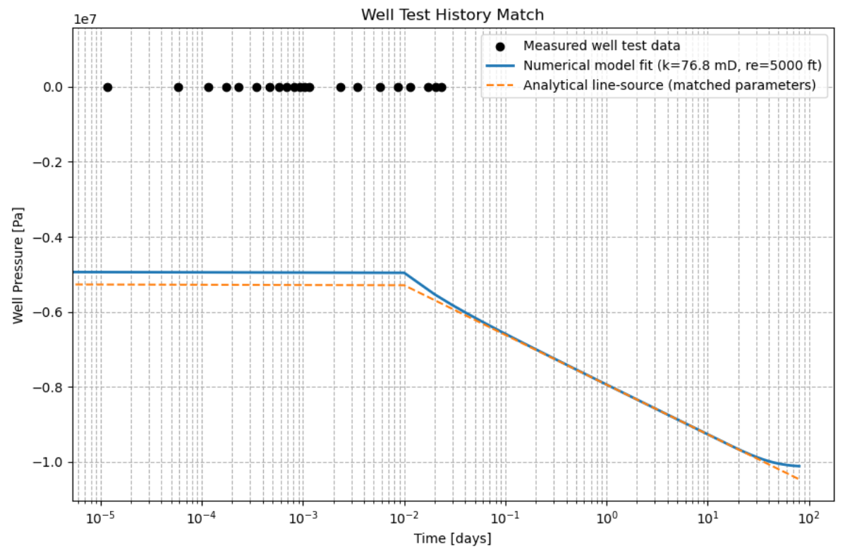

Matching Numerical Model to
Field Data
Parameter fitting $k, p_{i}, r_{e}$
Curve fit between measured data, numerical well pressure and Theis solution
Interpretation
  Early/intermediate match: Infinite acting
  Late plateau time: Boundary reached
  Line source keeps declining (no boundary)
Notes:
Exercise objective:
Fit parameters k, pi and re to data
Compare data, numerical solution, and Theis solution on log-time plot
Theory:
Parameter effects:
K; slope of semilog line
Pi; vertical offset
Re; late-time stabilization onset
Line-source keeps declining; numerical plateaus at boundary
Implementation
‘scipy.optimize.curve_fit’ to find best fit parameters
Simulated well pressure vs measured
Analytical theis computed with fitted parameters
Results:
Early/intermediate match is good for both line-source and numerical
Numerical curve levels off at late time (boundary felt)
Fitted parameters consistent with expected behavior)

Slide 12
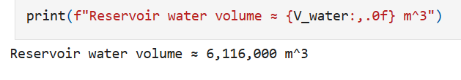
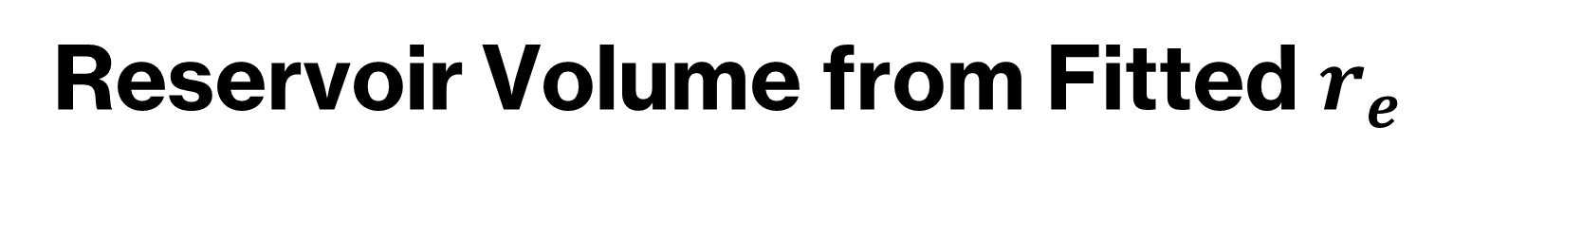

Reservoir Volume from Fitted $r_{e}$
$V_{w}=\text{ϕπ}\left(r_{e}^{2}−r_{w}^{2}\right)h$
Based fitting on $r_{e}$
Assumes homogenous porosity and water saturation = 1
Notes:
Exercise objective:
Calculate total water volume for fitted re
Theory:
V = ϕπ(re2​−rw2​)h
Assuming porosity ϕ (phi) and fully water saturated
Implementation:
Simple calculation using fitted re in SI units
Results:
Reservoir volume derived
Meaningful value consistent with late-time pressure
Assumes full saturation

Slide 13
Project Limitations and Alternatives
Assumptions
  Homogenous reservoir
  No skin or wellbore storage
  Fully implicit (1st order time)
Alternatives
  Higher order BC
  Pre factored sparse solver
  More complex boundary condition
Notes:
Reservoir does not change over time

Slide 14
Conclusions
Analytical solution provides clear benchmark for error analysis
Not-so-lazy BC achieves second order accuracy
Thomas algorithm outperforms other solvers
Numerical solution reproduces Theis behavior at intermediate times, and boundary dominated behavior at late times
Fitted parameters give physically meaningful reservoir size
Notes:
Exercise 1:
Analytical steady-state solution derived
Lazy BC gives first order error
Not-so-lazy BC gives second order error
exact match in our project
Exercise 2:
Implicit transient solver correctly constructed and validated
Exercise 3:
Numerical solution matches Theis in intermediate times and correctly deviates at late times when boundary is felt
Thomas algorithm offers best performance at large N
Although, expected better
Exercise 4:
Well test data successfully fitted for k, pi and re
Numerical model reproduces real well behavior including boundary effects
Overall:
Theory and simulations are consistent
Project demonstrates accuracy and computational efficiency of chosen numerical method.

